Slide 1
View groups

Slide 2
What is a ViewGroup ?
A ViewGroup is a big View that can contain smaller Views inside of it. The smaller Views are called the children of the ViewGroup and might be TextViews or ImageViews. The ViewGroup is called the parent of its children. The illustration shows one of the most common ViewGroups, a vertical LinearLayout.

Slide 3
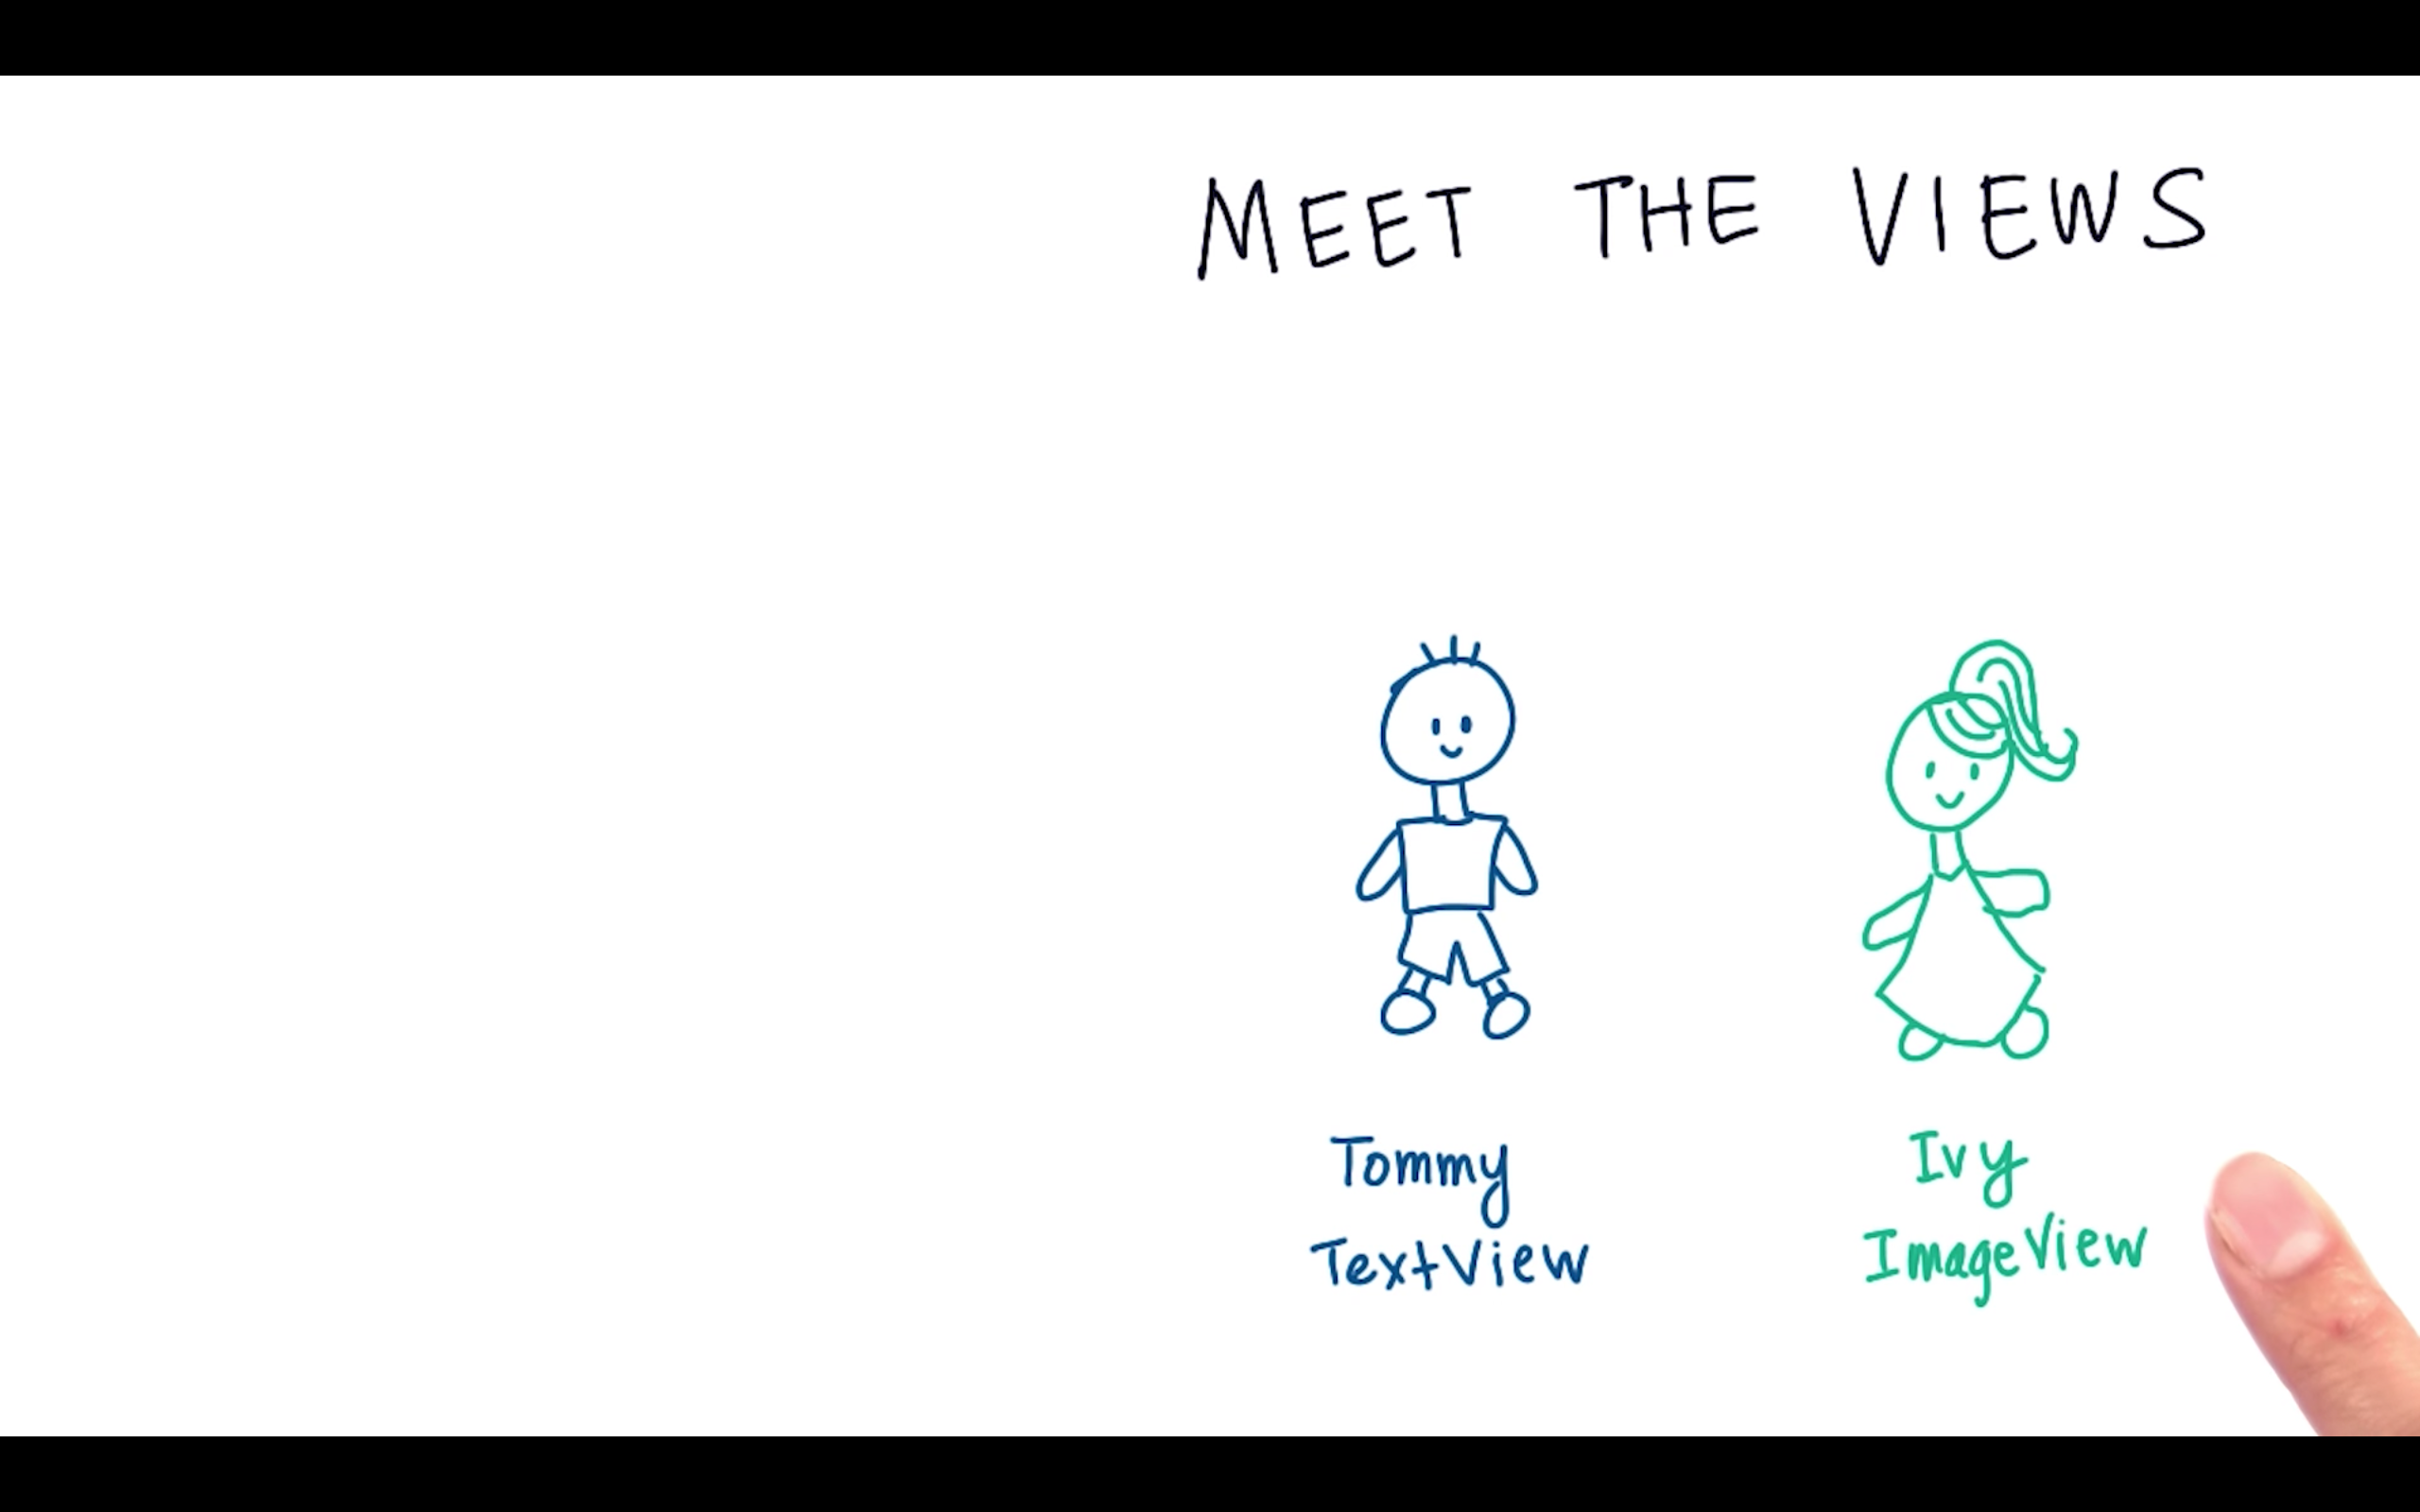

Slide 4
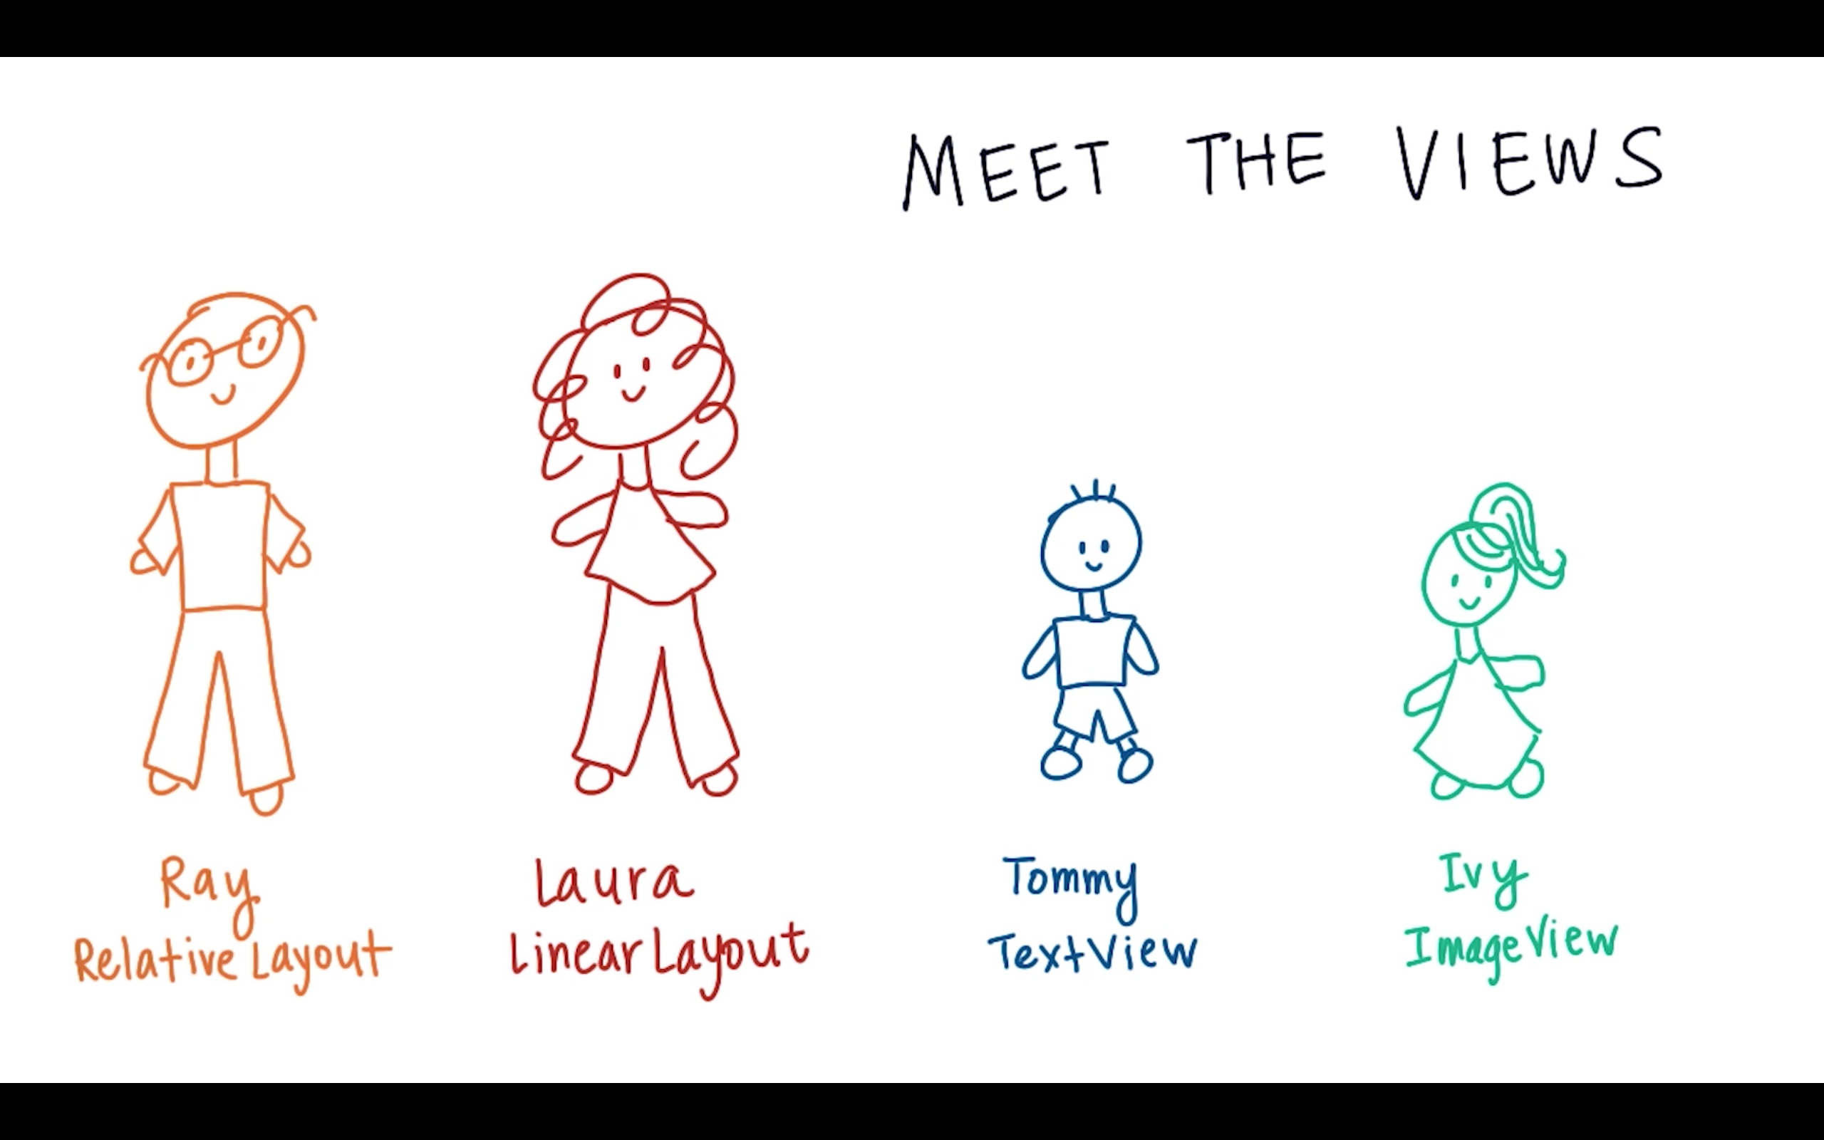

Slide 5
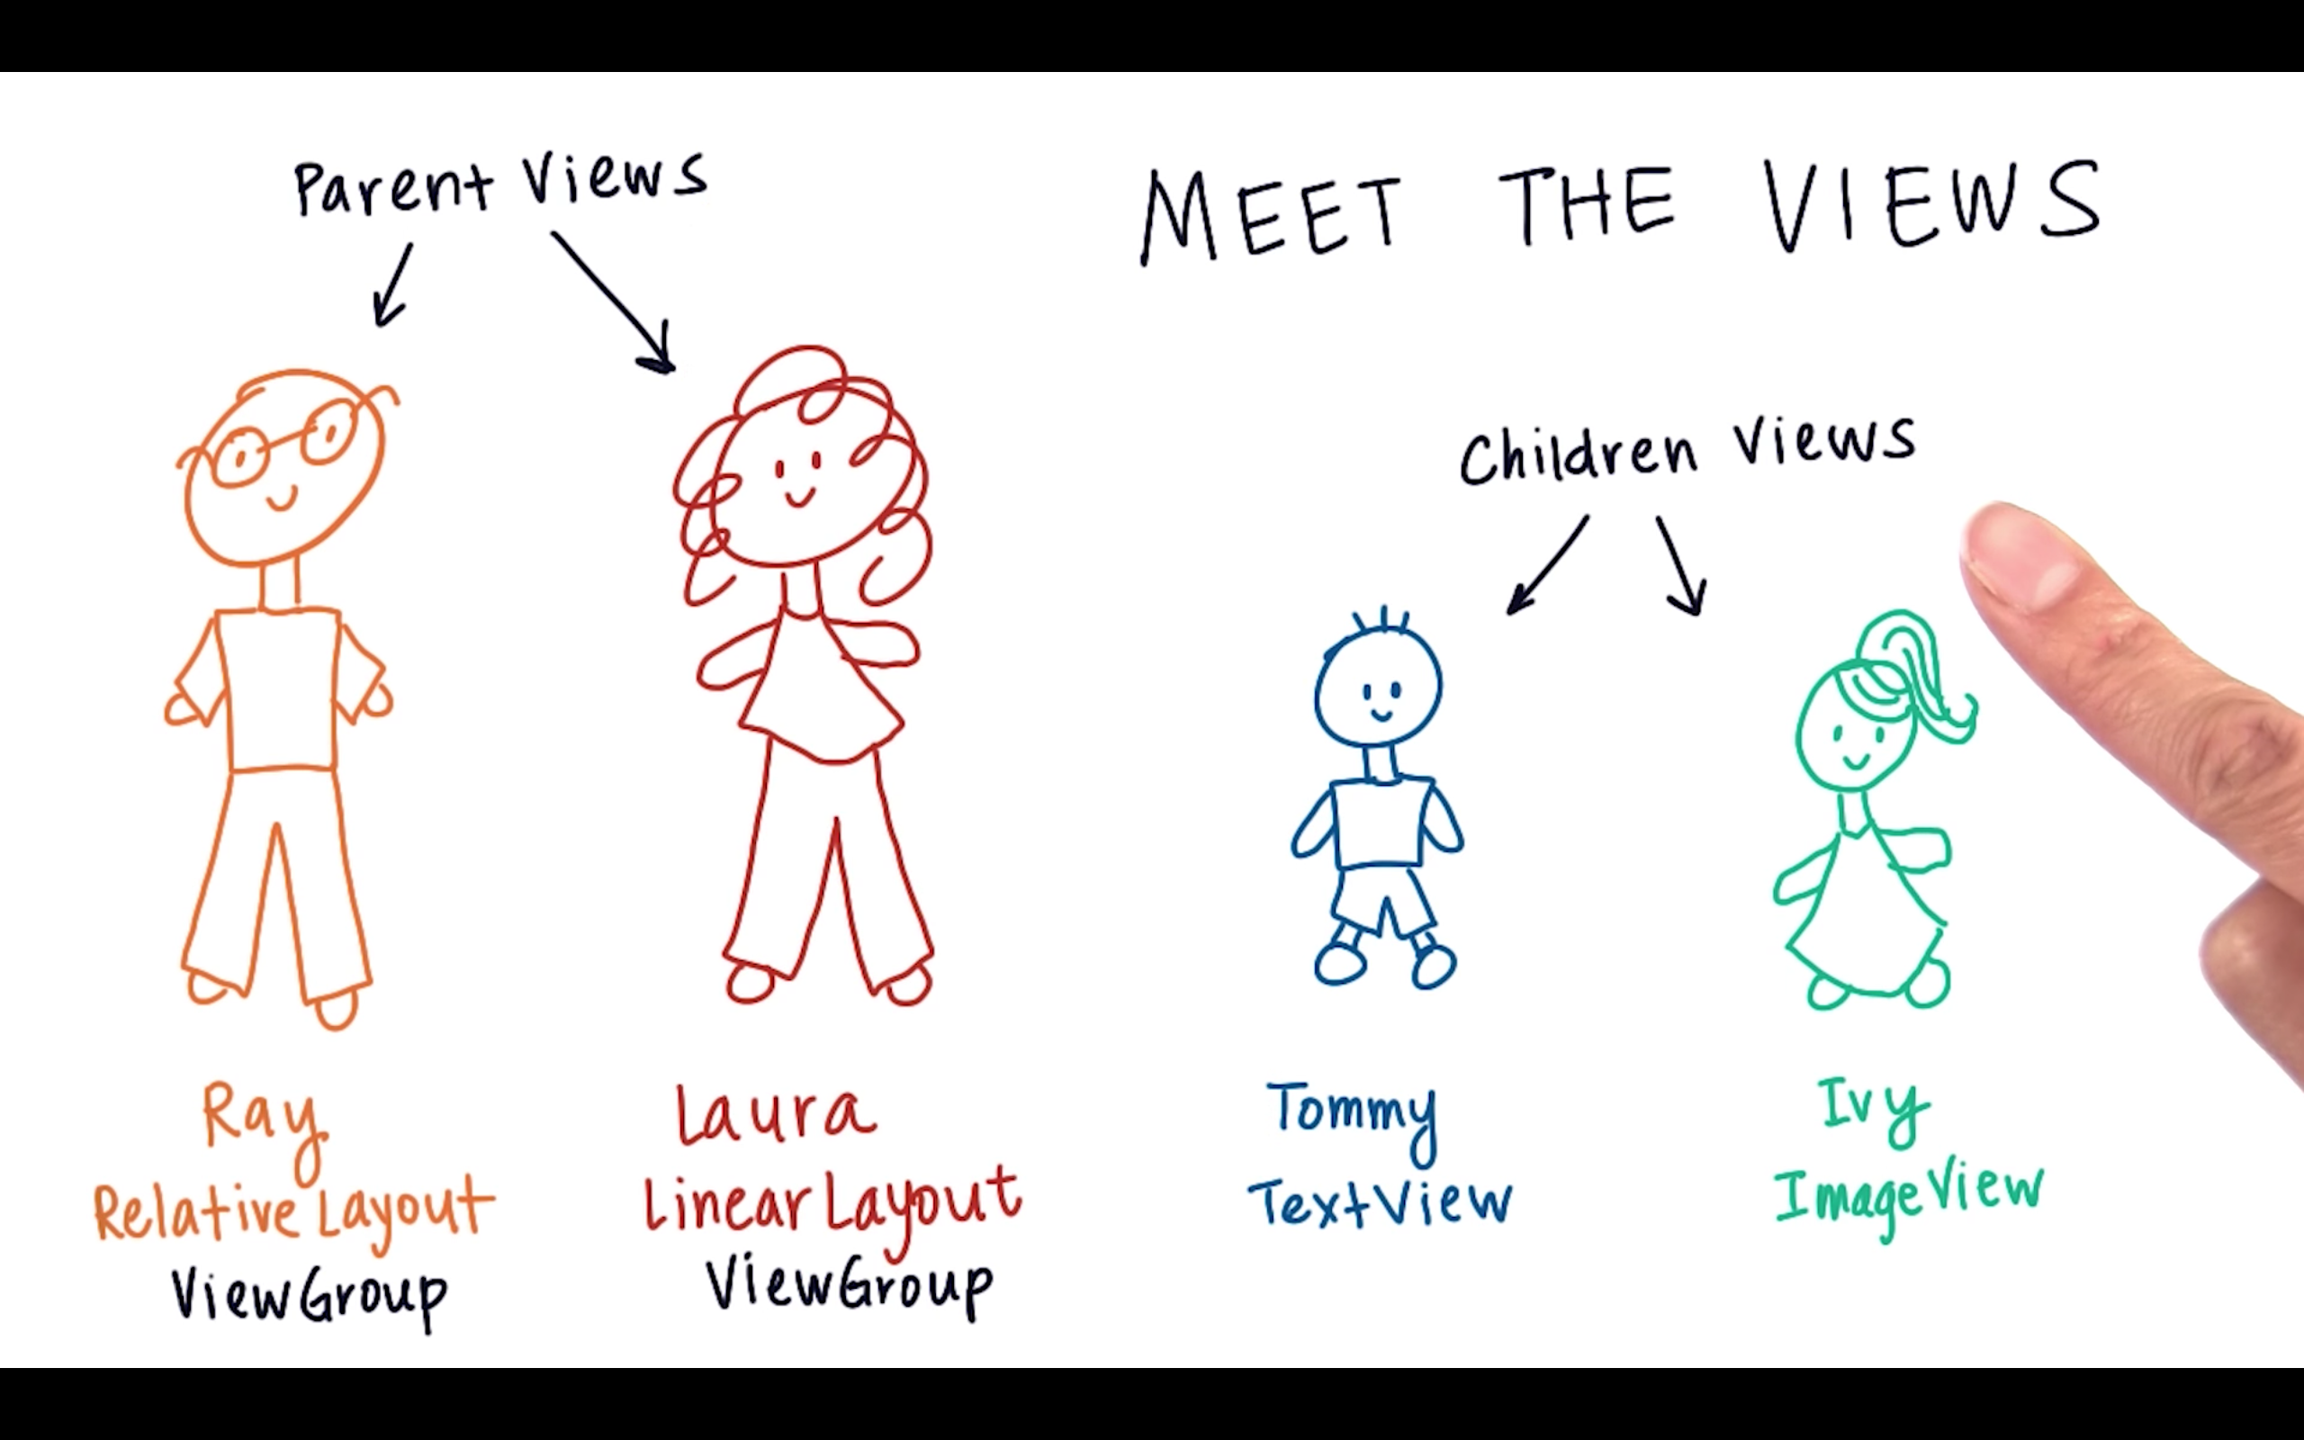

Slide 6
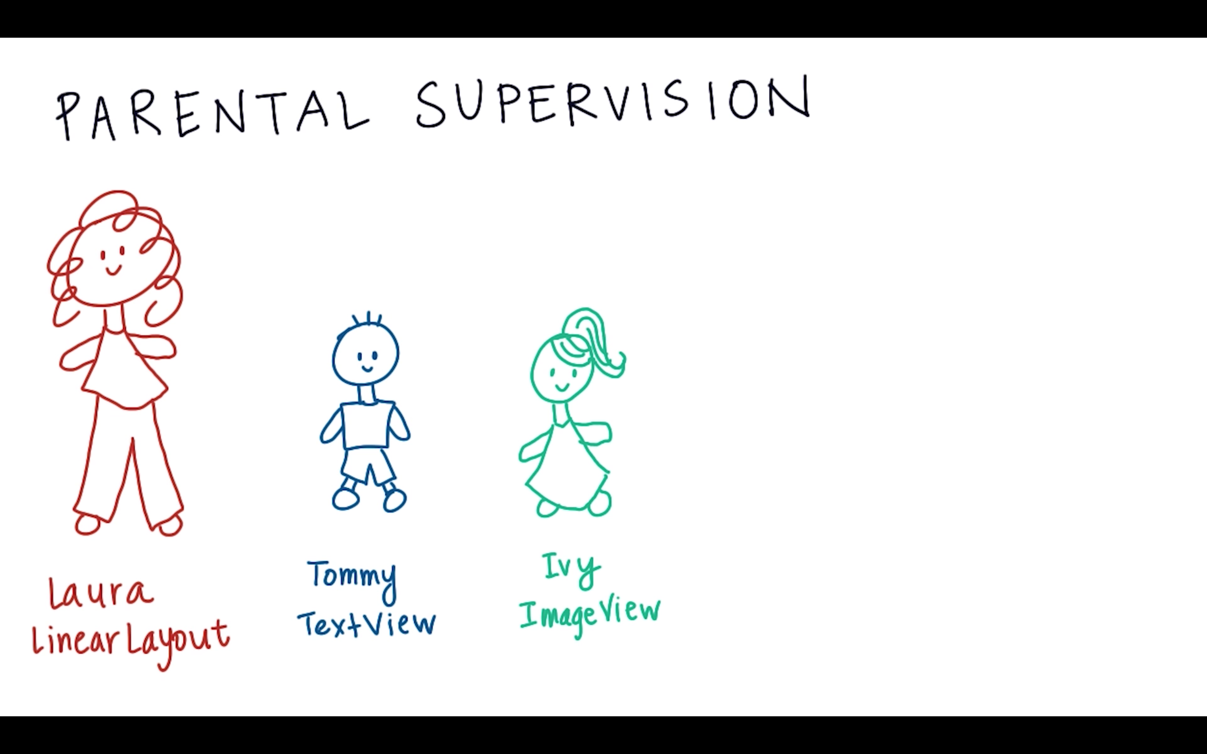

Slide 7
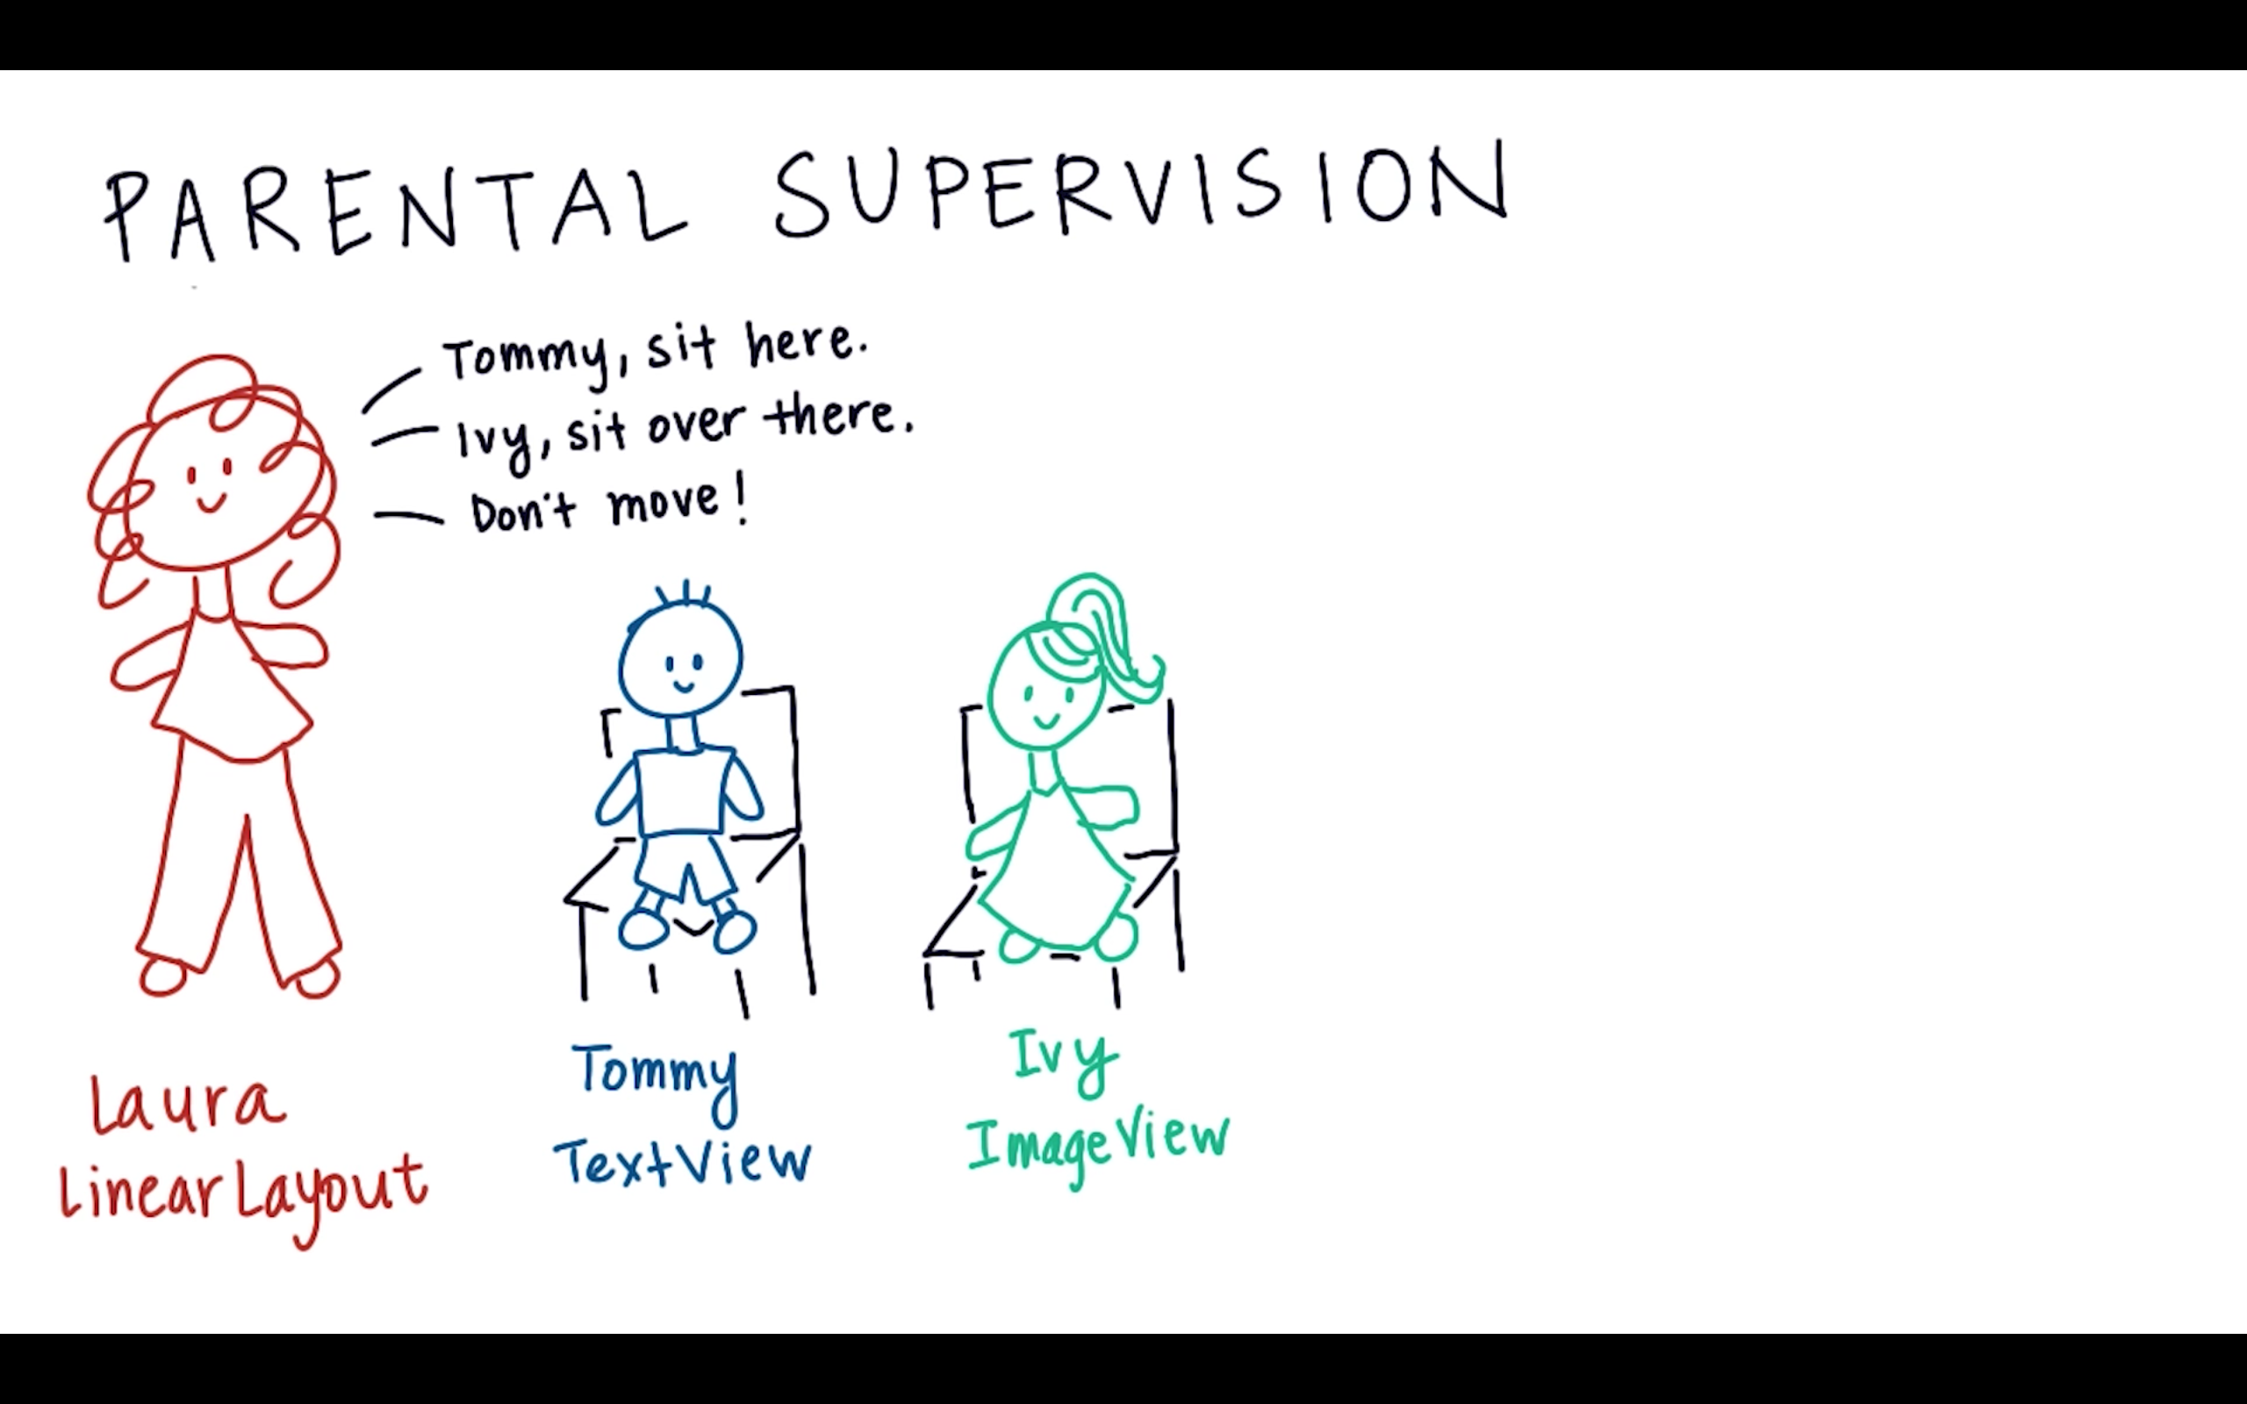

Slide 8
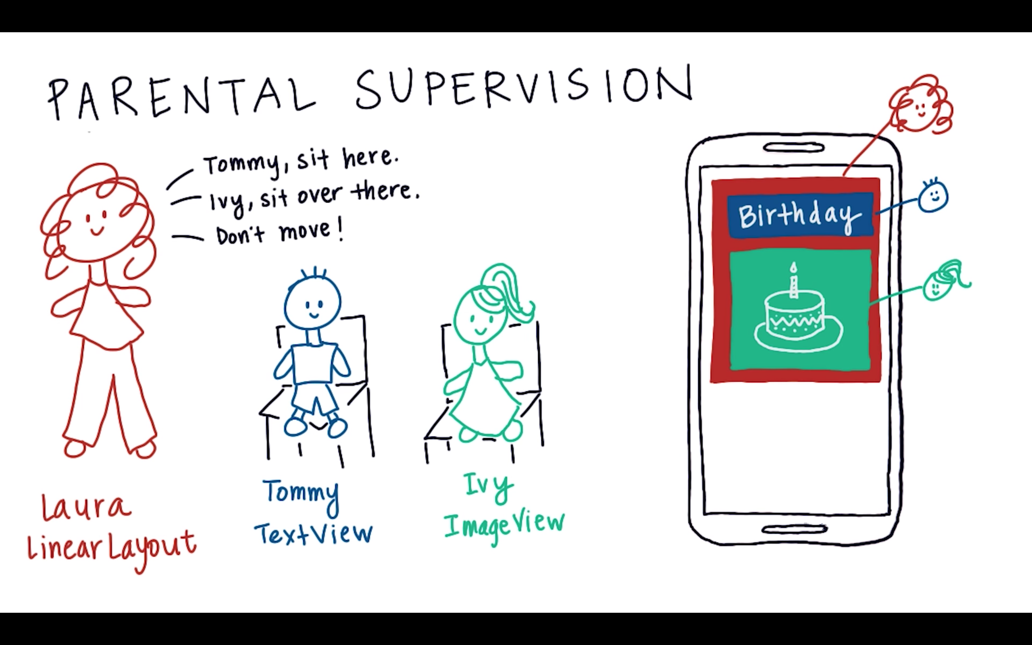

Slide 9
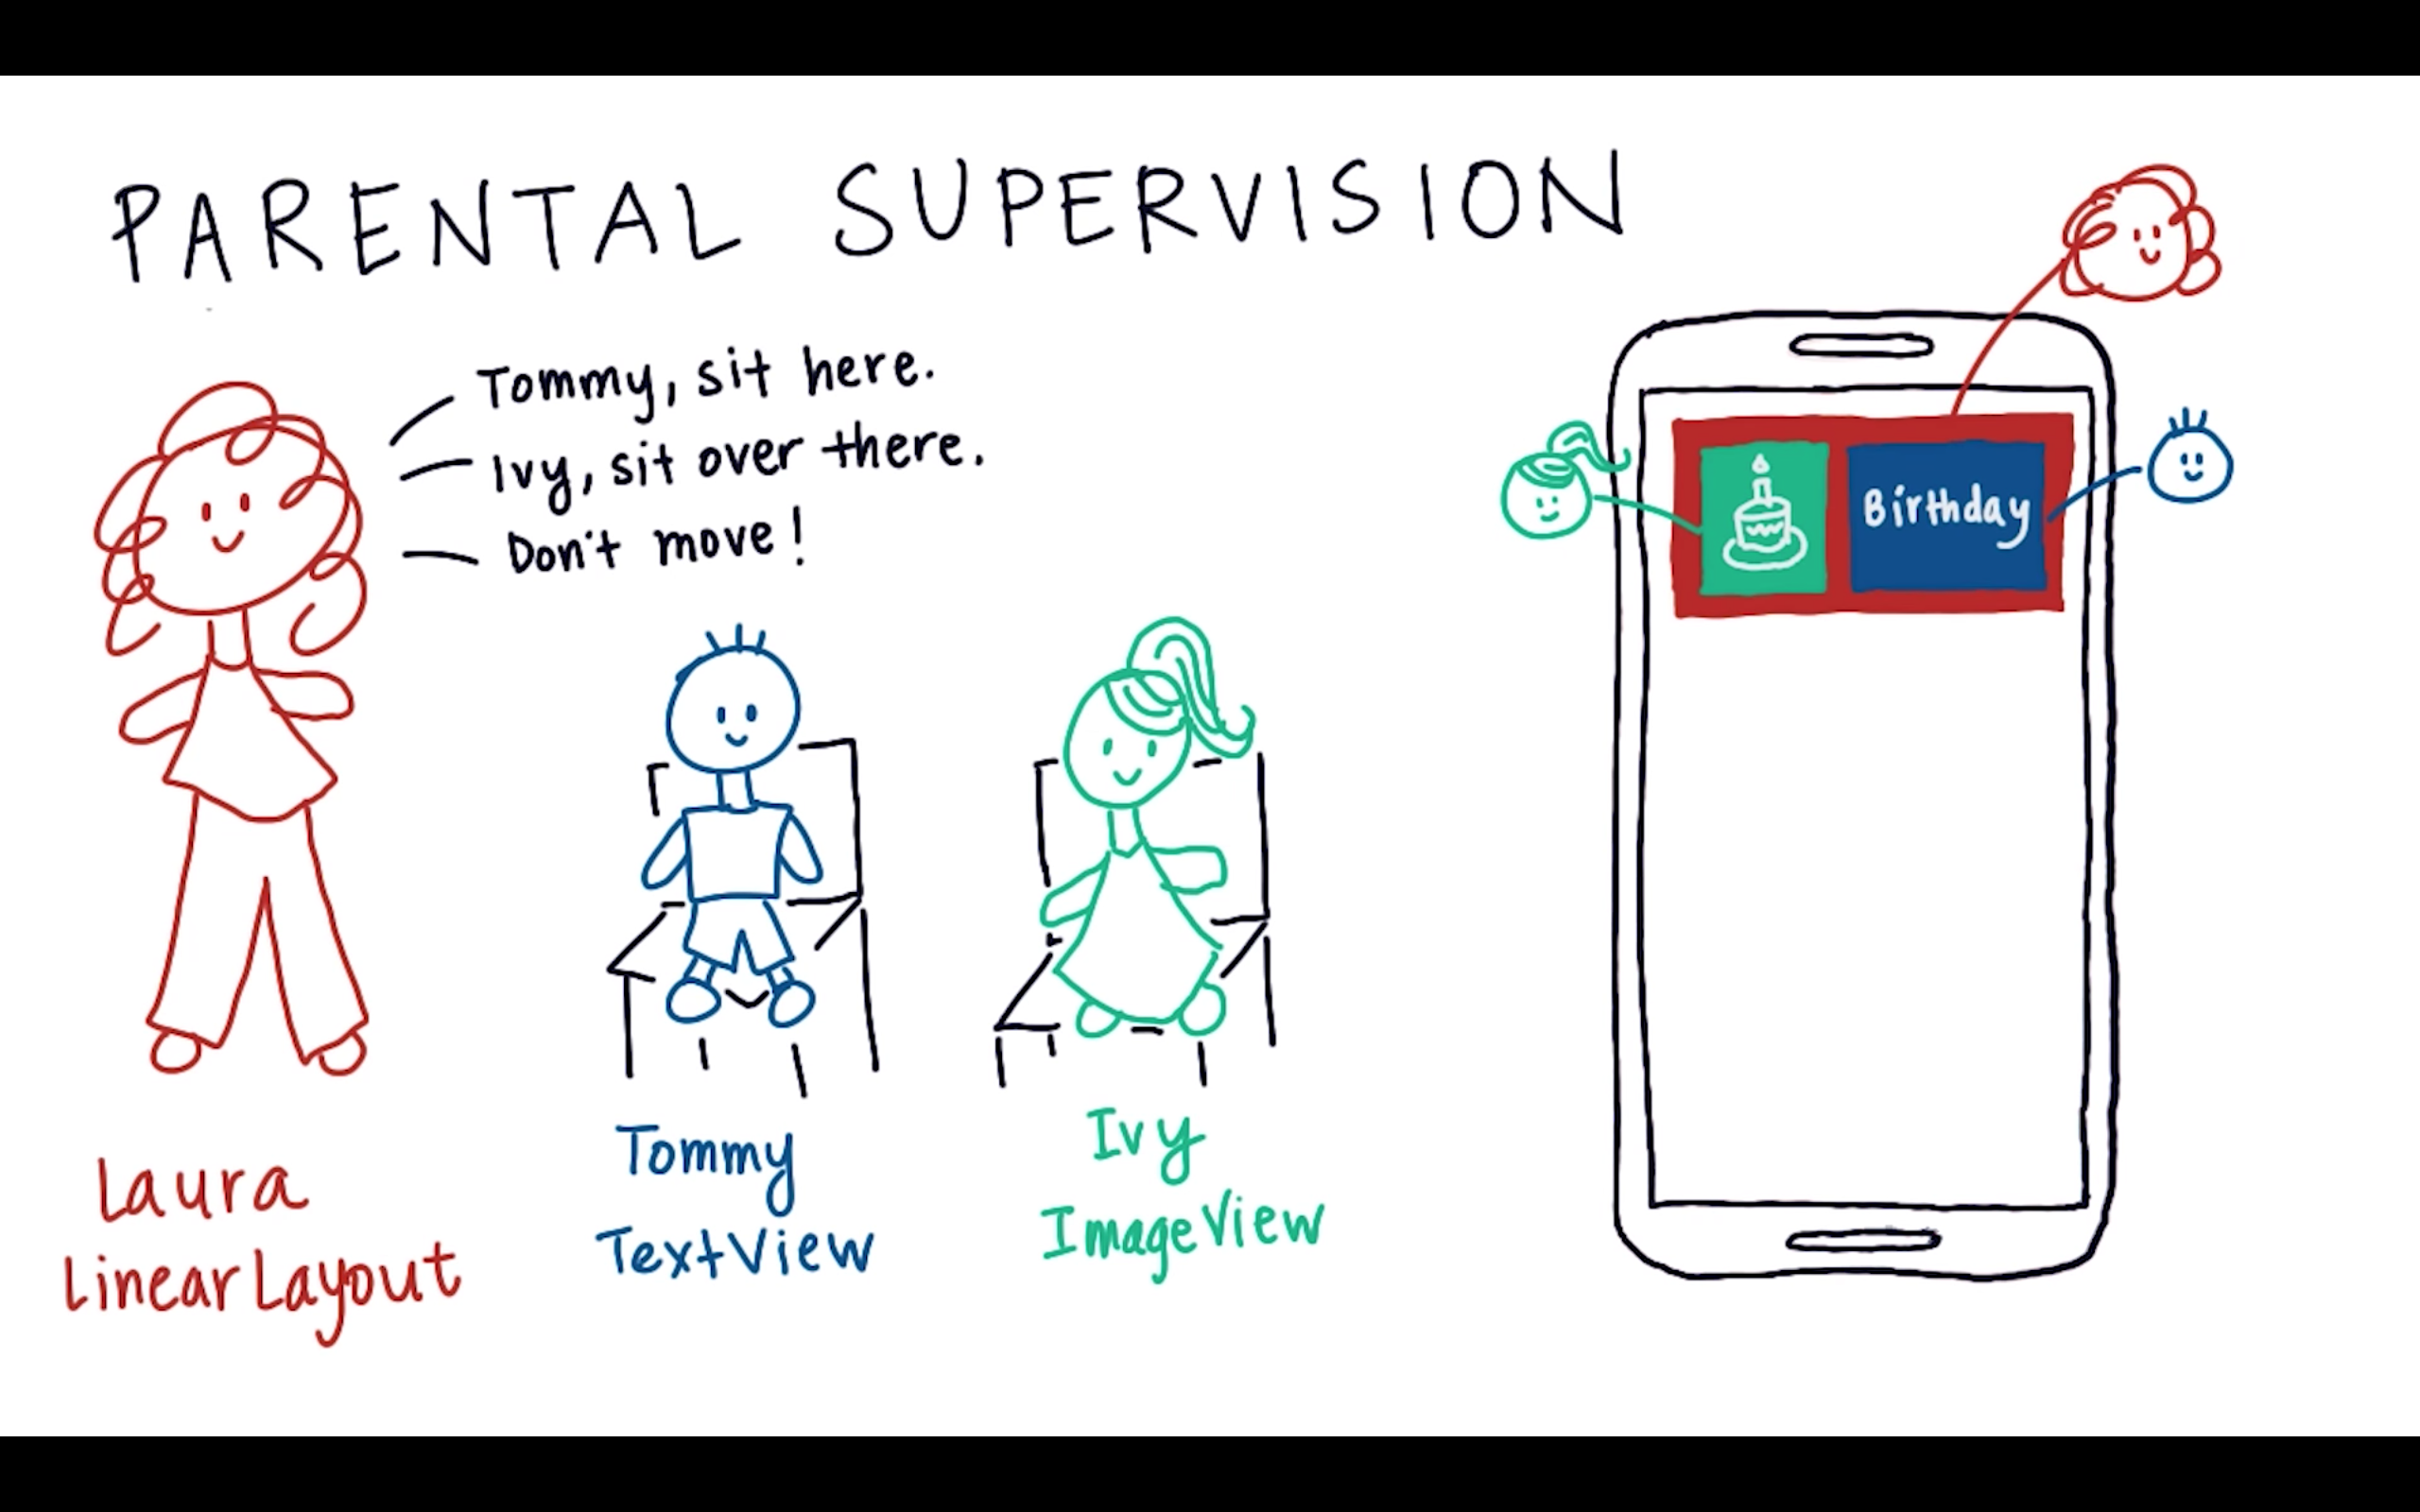

Slide 10
Quiz

Slide 11
